Slide 1
Natural Selection
Year 10 Pre-ATAR Science

Slide 2
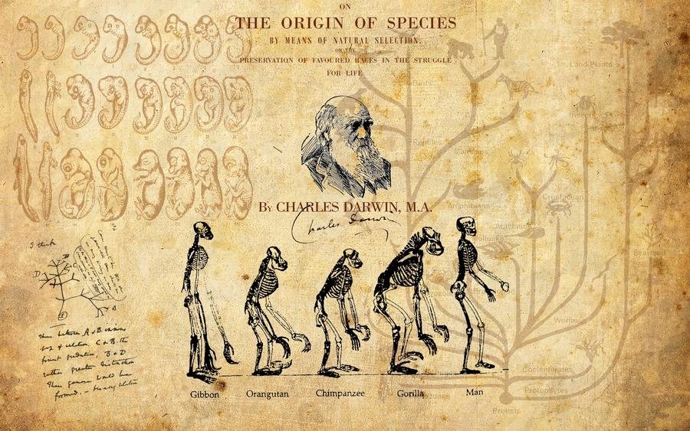

Slide 3
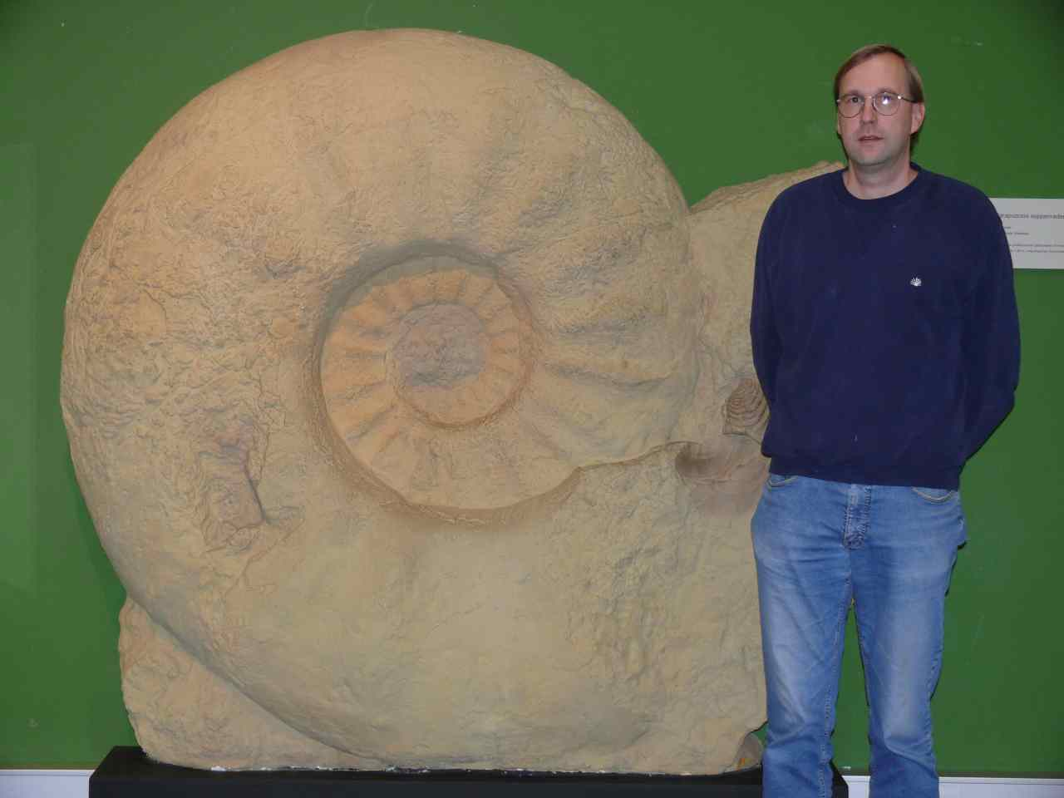
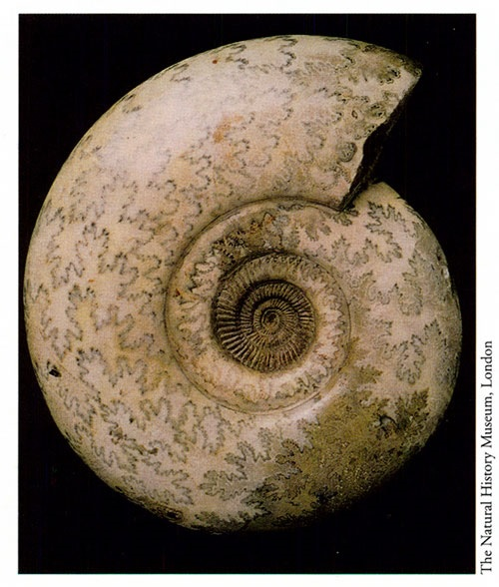
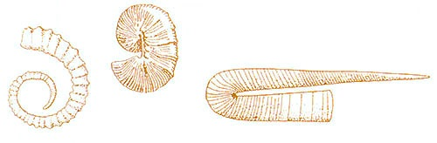
Review
Define biodiversity.
Which events in the geological time scale record the greatest changes in biodiversity? Explain.
Ammonites are index fossils with many different species throughout the Jurassic and Cretaceous periods.
a) What makes them useful as index fossils
b) Why do they no longer exist?

Slide 4
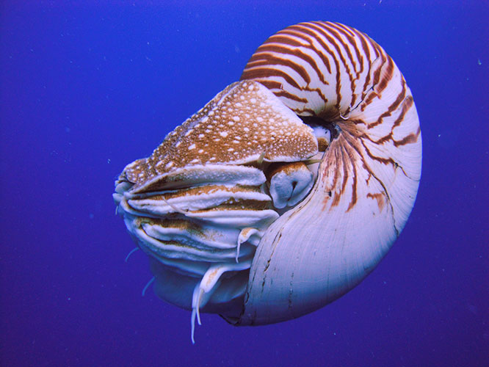

Slide 5
Learning Intention
Natural selection explains the diversity of living things

Slide 6
Success criteria
Define natural selection
Name the key steps
Identify one source of genetic variation
Give three examples of natural selection from ancient and modern species

Slide 7
Natural Selection
Natural Selection was described by Charles Darwin and Alfred Wallace as one of the mechanisms for evolution (or change of living things over time).

Slide 8
Natural selection
Those individuals best suited to an environment survive and reproduce most successfully, producing many similarly well-adapted descendants. After numerous such breeding cycles, the better-adapted dominate. Nature has filtered out poorly suited individuals and the population has evolved.

Slide 9
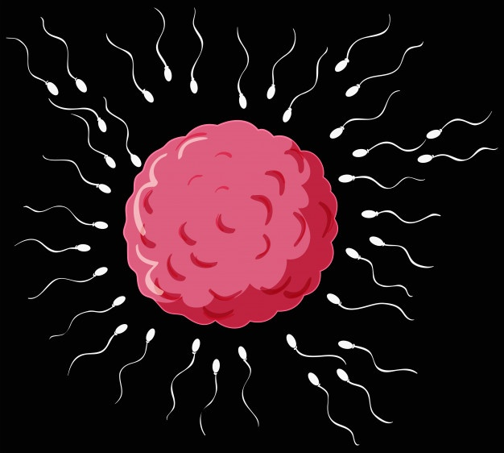
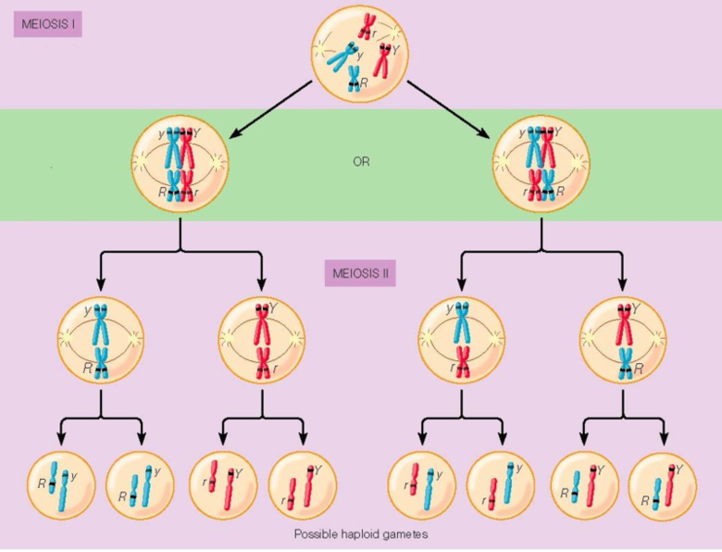
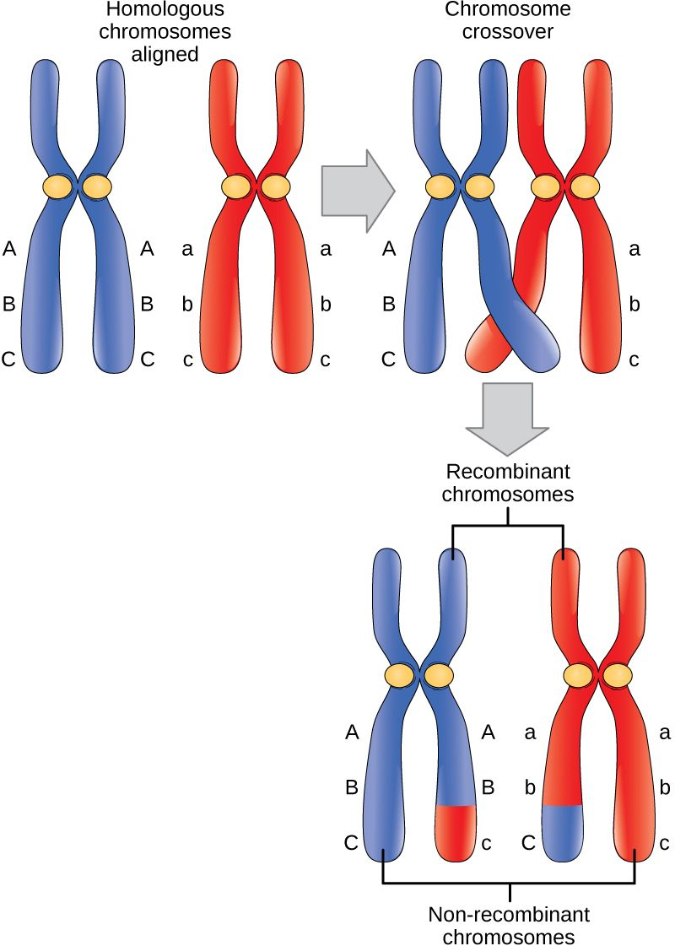
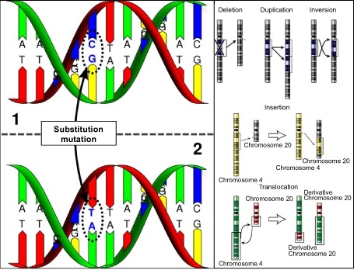
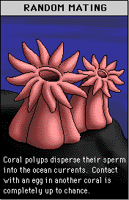
1. Variation
Individuals in any population or
species show variety due to
mutation
random mating
random fertilization
crossing over
independent assortment and random alignment

Slide 10
Competition, Survival of the Fittest and Inheritance
More offspring are born than will survive.
Individuals that are better at finding food, finding mates, protecting their offspring or hiding from predators will have more chance of surviving and passing on their genes to their offspring.

Slide 11
Adaptation and speciation
Over many generations, of successful traits being passed on, a population will change and adapt to its environment.
Speciation – becoming a whole new species – will happen if populations are separated and exposed to differences in environment.

Slide 12
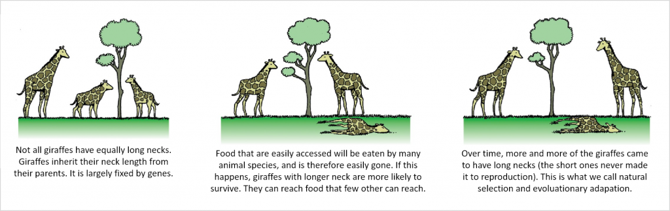

Slide 15
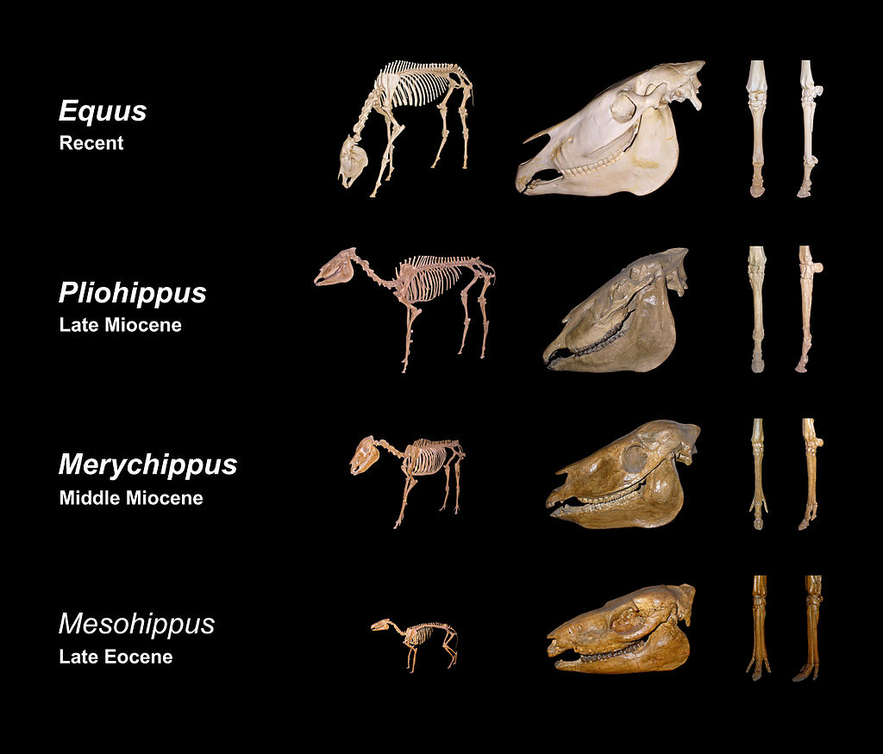

Slide 16
Survival of the fittest
https://learn.genetics.utah.edu/content/evolution/advantage/

Slide 17
https://coolsciencelab.com/who_wants_to_live_a_million_years.htm
Ruffle - Flash Emulator - Chrome Web Store (google.com)

Slide 18
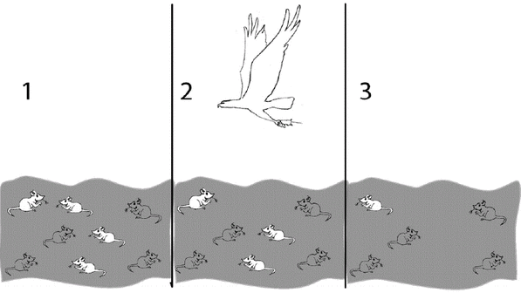

Slide 19
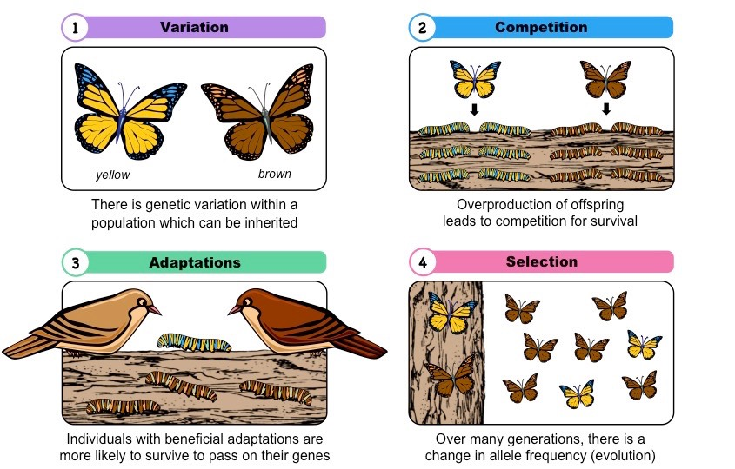

Slide 20


Slide 21
https://phet.colorado.edu/sims/html/natural-selection/latest/natural-selection_en.html

Slide 22
Success criteria
Define natural selection
Name the key steps in order
Identify one source of genetic variation
Give three examples of natural selection from ancient and modern species

